Slide 1
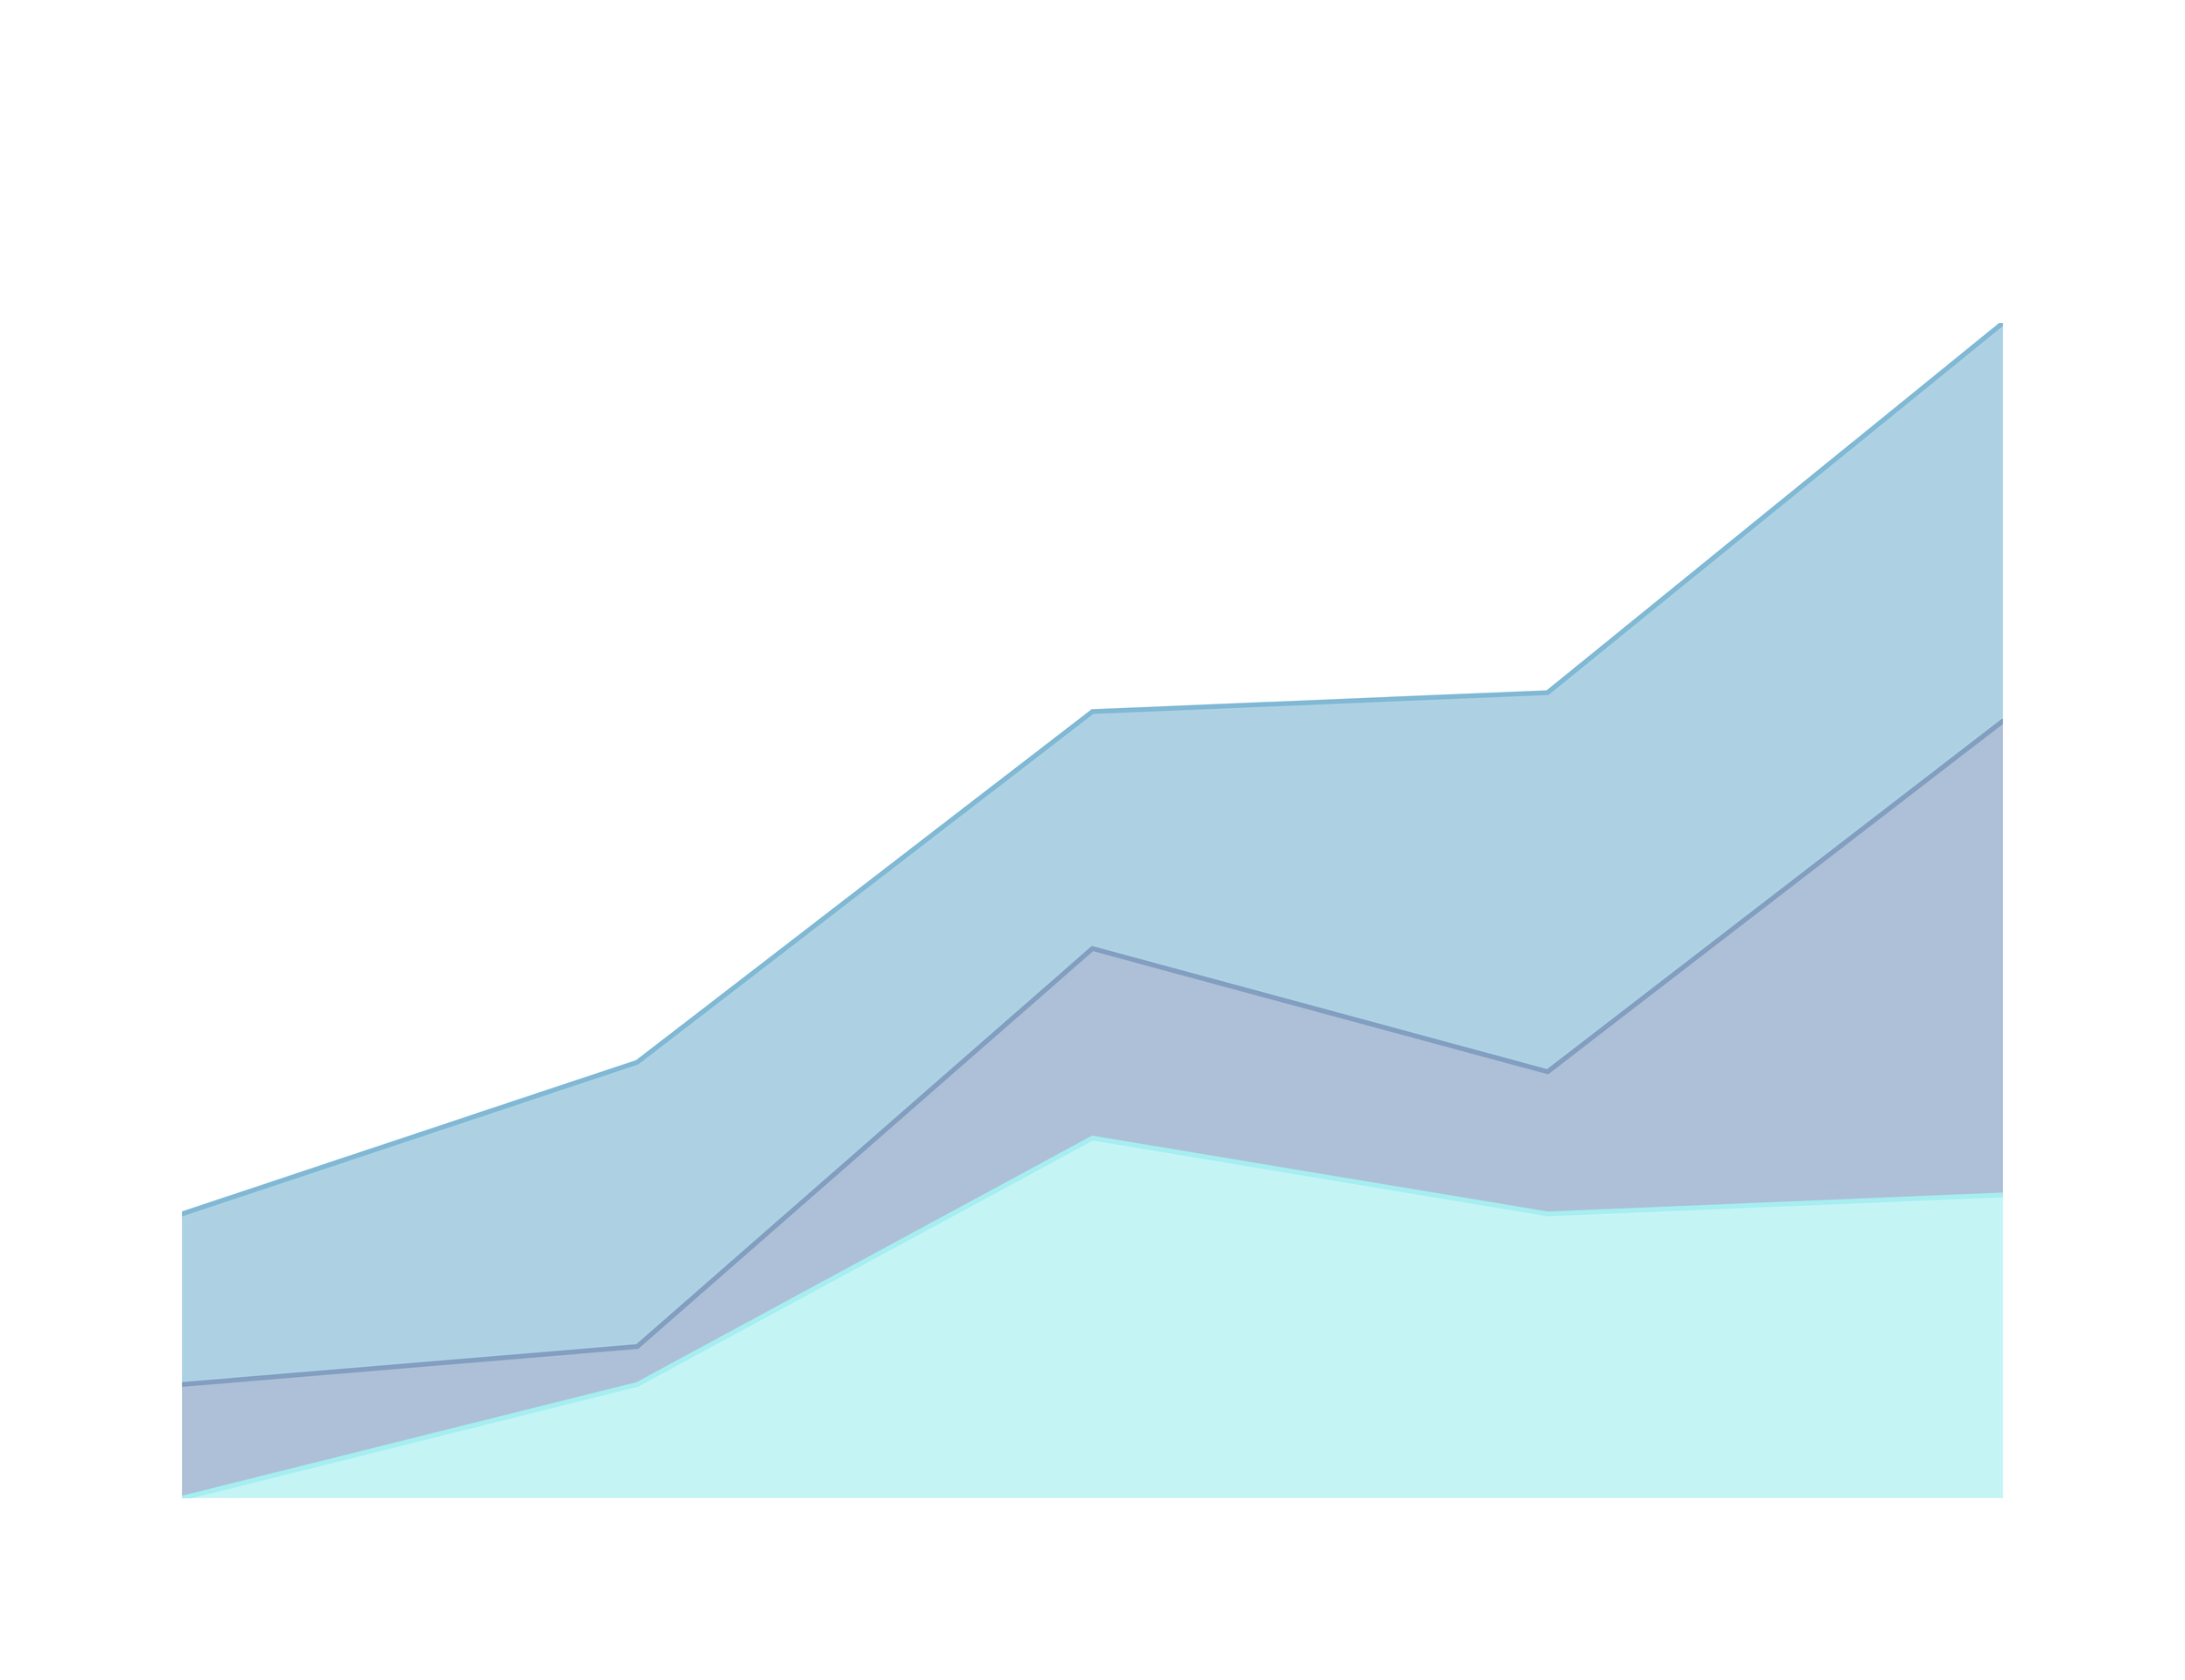


Supply Chain
Visualization Hunters

Slide 2



Team Members:
Abdullah Sayed
(Cleaning)
1
Bahy Mohsen
(leader, Report,
Dashboard)
4
Eyad Ashraf
(Dashboard,
Report)
2
Ahmed Kotob (cleaning)
5
Ahmed Hossam
(Dashboard)
Seif Medhat
(Cleaning ,Report)
3
6

Slide 3
Content
1
About Data
2
Data cleaning
3
Dashboard

Slide 4
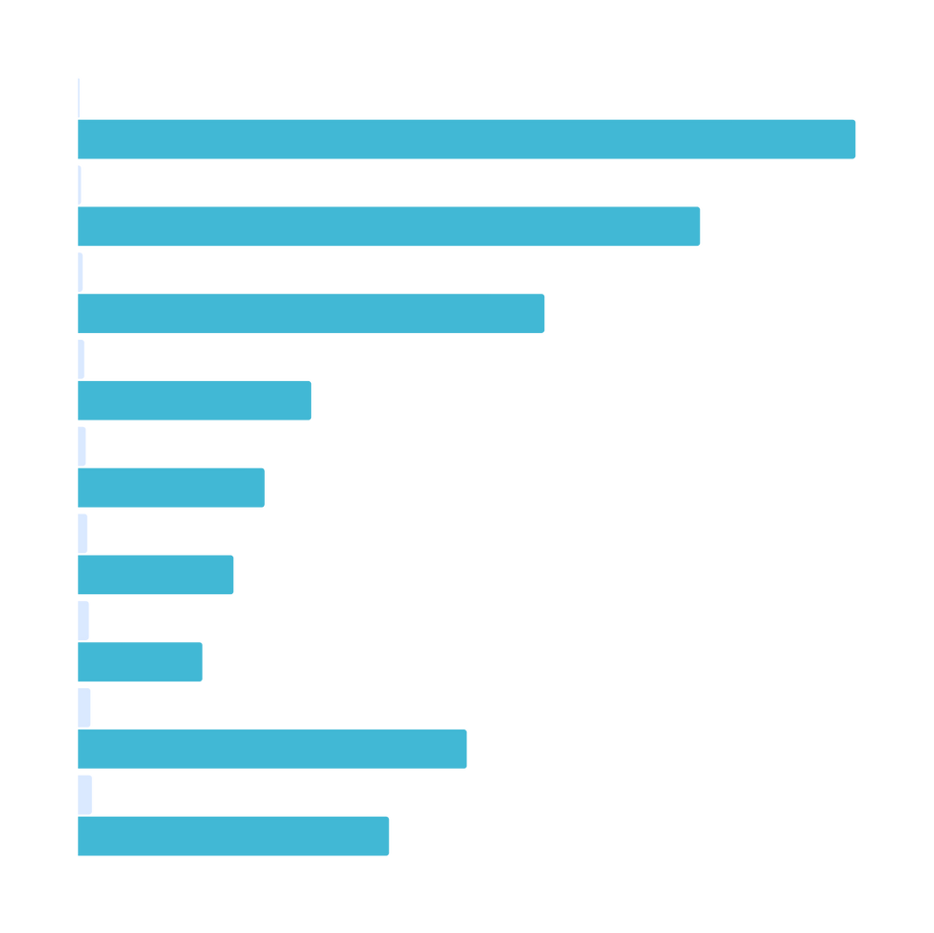
About Data

Slide 5
Story Telling
The Cost of Delivering Care:
Every day, essential medicines travel across borders to reach those in need, but behind each delivery lies a complex web of logistics and costs. The 'Supply Chain Shipment Pricing' dataset by USAID unpacks the expenses of transporting health commodities, revealing key insights on transportation modes, routes, and seasonal variations.
By analyzing this data, USAID can optimize routes, cut costs, and negotiate better contracts, ensuring that funds stretch further. Each dollar saved means more medicines delivered, more lives saved. This data-driven approach to logistics transforms shipping strategies, paving the way for healthier communities worldwide.

Slide 6
Over View
The cleaned dataset consists of 9,864 rows and 28 columns, which is a reduced version of the original dataset (10,324 rows and 33 columns). This cleaning process aimed to remove unnecessary columns, handle missing values, and ensure data consistency. Below is a comprehensive report detailing the changes made during the data cleaning process.

Slide 7
Data Cleaning

Slide 8


1.Dropped Columns
In the cleaned dataset, five columns from the original were removed. These columns likely contained redundant or irrelevant data. The dropped columns include:
- PQ #
- PO / SO #
- ASN/DN #
- PO Sent to Vendor Date
- Line Item Insurance (USD)
These columns may have been excluded because:
- They added no significant value to the analysis.
- The data was inconsistent or incomplete.
- It was possible to derive relevant information from other columns.

Slide 9
2.Handling Missing Value
The non-cleaned dataset had missing values in several important columns such as:
- Shipment Mode (missing for 360 rows)
- Dosage (missing for 1,736 rows)
In the cleaned dataset:
- Shipment Mode and Dosage columns are fully populated, implying either the missing values were imputed or these rows were removed.
Steps to clean the missing data:
- Imputation: Possible replacement with default or average values for categories such as 'Air,' 'Sea,' or 'Road' for the 'Shipment Mode' column.
- Row Removal: Rows with missing values may have been dropped if the data could not be reasonably imputed.

Slide 10
3.Data Format Standardization
Several date columns in the dataset were cleaned and standardized:
- Scheduled Delivery Date
- Delivered to Client Date
- Delivery Recorded Date
In the non-cleaned dataset, these columns were a mix of date strings and datetime64 objects. The cleaned dataset ensures all date columns are consistently in datetime64[ns] format, making it easier to perform date-based analyses such as lead time calculations.

Slide 11
4. Data Type Correction
Columns with numerical values were checked for proper data types:
- Line Item Quantity, Line Item Value, Pack Price, and Freight Cost (USD) are now uniformly set as numerical data types (float64 or int64).
- Non-numeric columns like Project Code, Vendor INCO Term, and Product Group are standardized as strings (object types).

Slide 12
5. Outliers Removal
Rows with extreme or unreasonable values in important financial columns, such as Freight Cost (USD) or Line Item Value, were likely removed. For instance, rows with unreasonably high or low values that would distort the overall analysis were cleaned. This step helps in ensuring more accurate and meaningful statistical analysis.

Slide 13
6. Consistent Naming and Formatting
Standardization of entries in categorical columns, such as Shipment Mode and Vendor INCO Term, ensures there are no inconsistent or mixed-case values like 'air' vs 'Air' or 'sea' vs 'Sea'. In the cleaned dataset, all entries for Vendor INCO Term appear uniformly, with terms like 'EX Works' or 'Free Carrier' standardized.

Slide 14
7. Duplicate Rows Removal
Standardization of entries in categorical columns, such as Shipment Mode and Vendor INCO Term, ensures there are no inconsistent or mixed-case values like 'air' vs 'Air' or 'sea' vs 'Sea'. In the cleaned dataset, all entries for Vendor INCO Term appear uniformly, with terms like 'EX Works' or 'Free Carrier' standardized.

Slide 15
8. Outlier Detection and Handling
The cleaned data likely underwent an outlier detection process, where unusually high or low values were removed, specifically in columns such as:
- Freight Cost (USD)
- Line Item Value
- Weight (Kilograms)
This ensures the analysis is not biased by outliers.

Slide 16
9. Reduction of Rows
The reduction from 10,324 rows to 9,864 rows indicates that 460 rows were either erroneous or irrelevant. These rows might have contained inconsistent or incomplete data, which were either cleaned or removed.

Slide 17
10. New Dataset Characteristics
The cleaned dataset retains the following key columns:
- Project Code: Still included for identifying shipments.
- Country: For geographic analysis of shipping routes.
- Shipment Mode: Now fully populated and ready for analysis of shipping methods.
- Line Item Quantity, Line Item Value, Pack Price: Cleaned and properly formatted for financial analysis.
- Freight Cost (USD): Cleaned to provide insights into shipping costs.
- Weight (Kilograms): Now fully filled, this column can be used for weight-cost analysis.

Slide 18
Dashboard

Slide 19
Agenda
Shipment and Delivery Analysis Dashboard
On-Time vs. Delayed Shipments by Country (Bar Chart)
Shipment Fulfillment Methods (Pie Chart)
Average Delivery Delay by Product Category (Bar Chart)
On-Time Shipments by Shipment Mode (Tree Map)
Average Delay Time by Country (Map)
Top 10 Vendors Ranked by Delivery Delay (Horizontal Bar Chart)
Cost and Quantity Analysis Dashboard
High-Cost Shipments by Freight Cost (Horizontal Bar Chart)
Quantity by Year (Line Chart)
Unit Price by Product Category (Line Chart)
Top 5 Vendors Share by Total Spend (Pie Chart)
Total Spend by Country (Bar Chart)

Slide 20
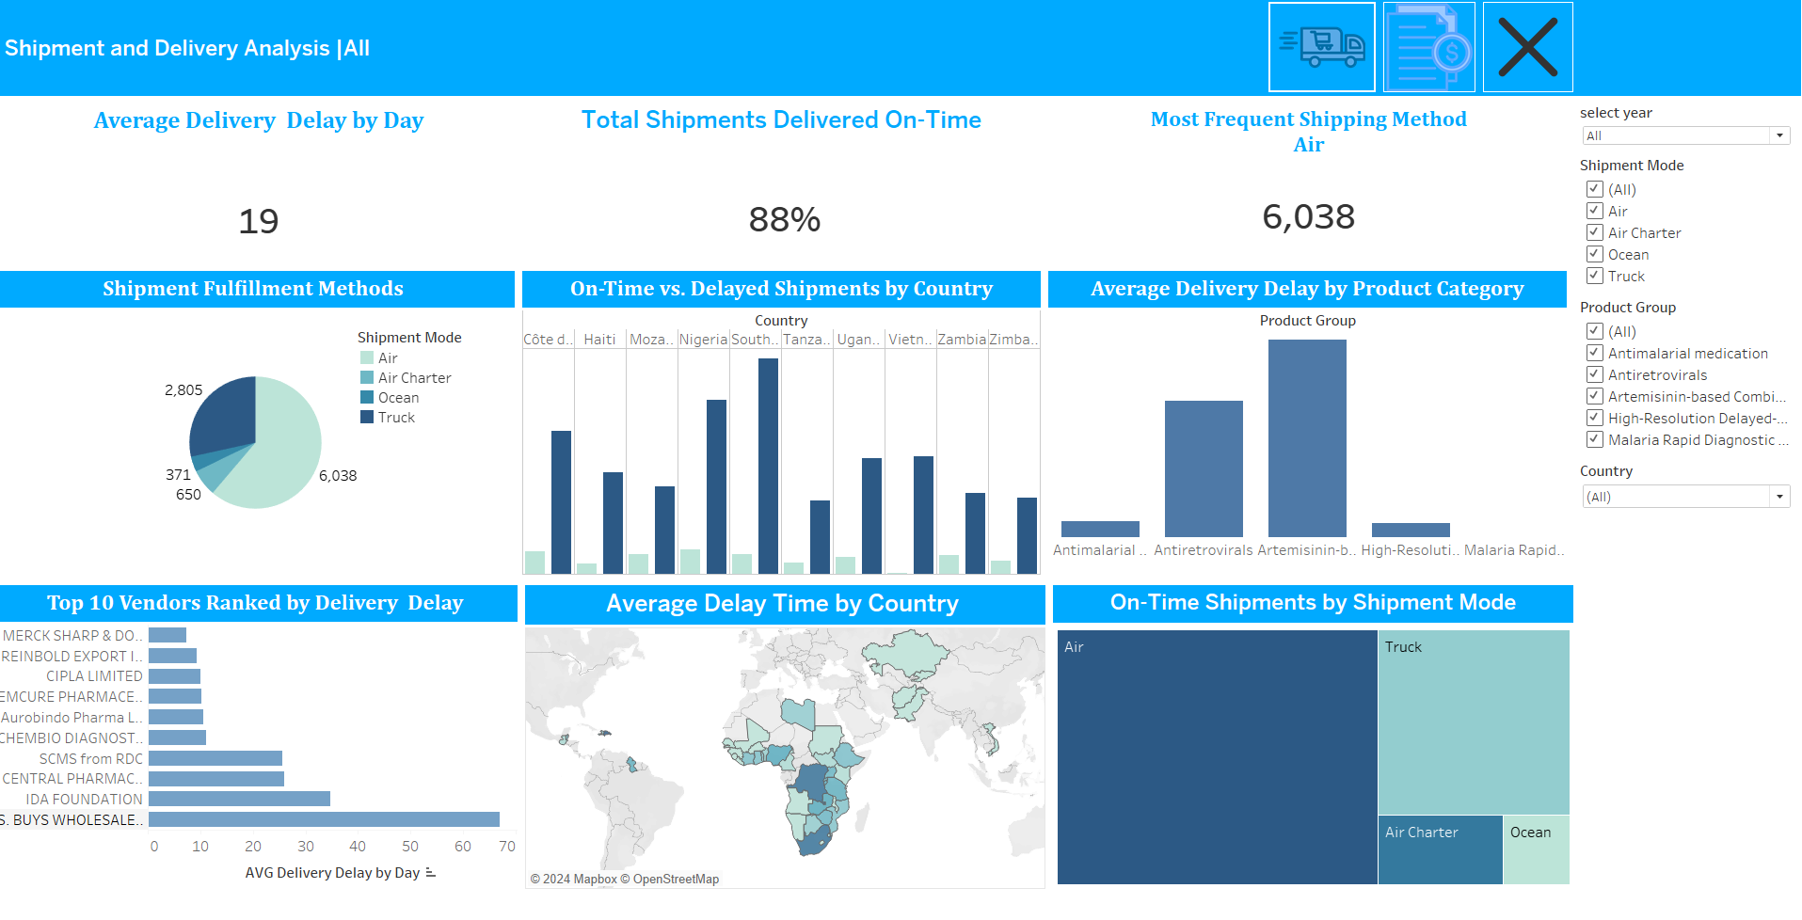
Dashboard 1

Slide 21

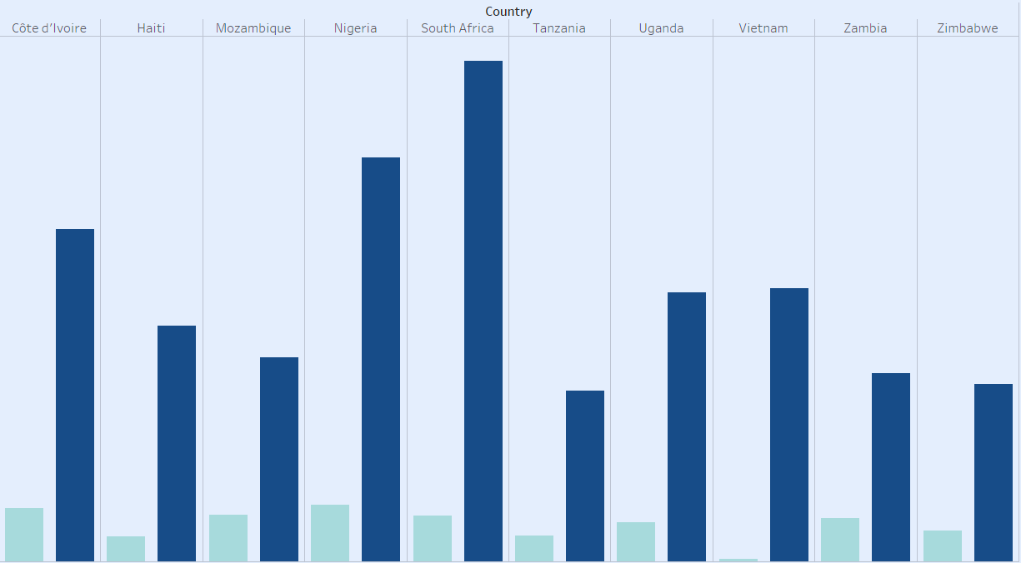

On-Time vs. Delayed Shipments by Country
Description:
A bar chart comparing on-time shipments versus delayed shipments for each country.
Key Insights:
South Africa
has a high count of on-time shipments, suggesting efficient logistics and well-established transportation routes in that region.
Notes:
13

Slide 22
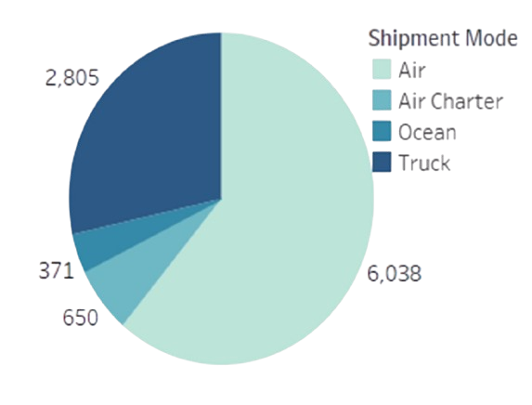
Shipment Fulfillment Methods
Description:
A pie chart that displays the distribution of shipments across different fulfillment methods: Air, Air Charter, Ocean, and Truck.
Key Insights:
•Air is the most commonly used fulfillment method.
•Air Charter and Ships are used less frequently.

Slide 23
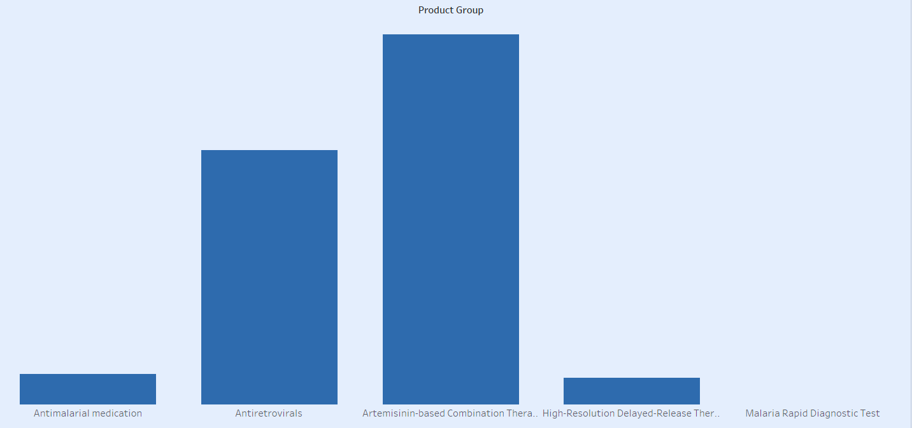

Average Delivery Delay by Product Category
•Description:
A bar chart displaying the average delivery delay for each product category, with product category
•Key Insights:
•Product Category Artemisinin-based Combination Therapies, shows the longest delivery delay,
•Product Category Malaria Rapid Diagnostic Test has the shortest average delivery delay,

Slide 24
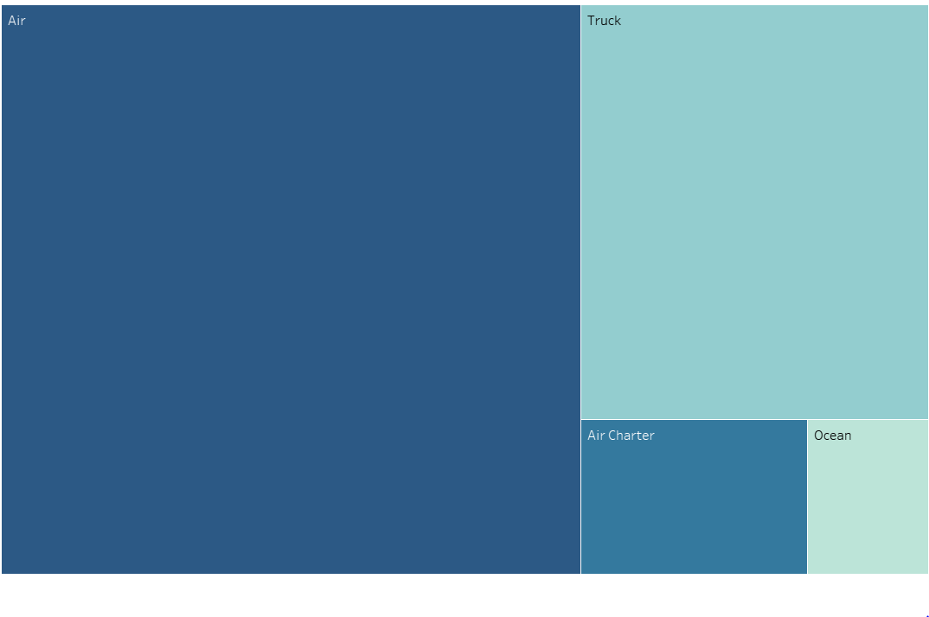
On-Time Shipments by Shipment Mode
Description:
A tree map displaying the proportion of on-time shipments for each shipment mode (e.g., Air, Air Charter, Ocean, Truck)
Key Insights:
•91% of Air Shipments are delivered on time, confirming air as the most reliable mode for timely shipments.
•82% of Ocean Shipments are delivered on time, but they represent the smallest on-time performance compared to other modes.

Slide 25
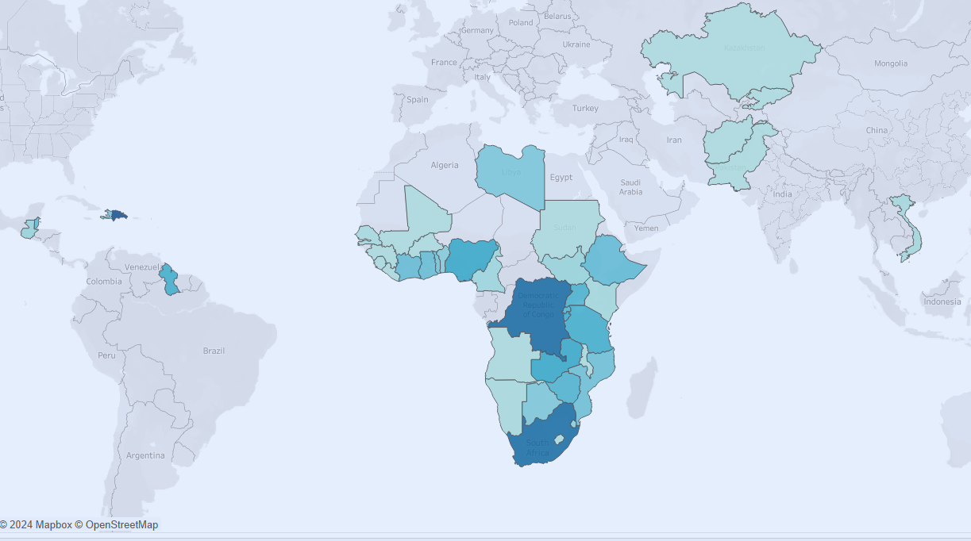
Average Delay Time By Country
Description:
A geographic map that displays average delivery delay times by country. Each country is color-coded based on its average delay, with darker shades indicating longer delays.
Key Insights:
•Kongo exhibits the longest average delay, which may be due to customs regulations, transportation issues, or distance from the main distribution center.

Slide 26
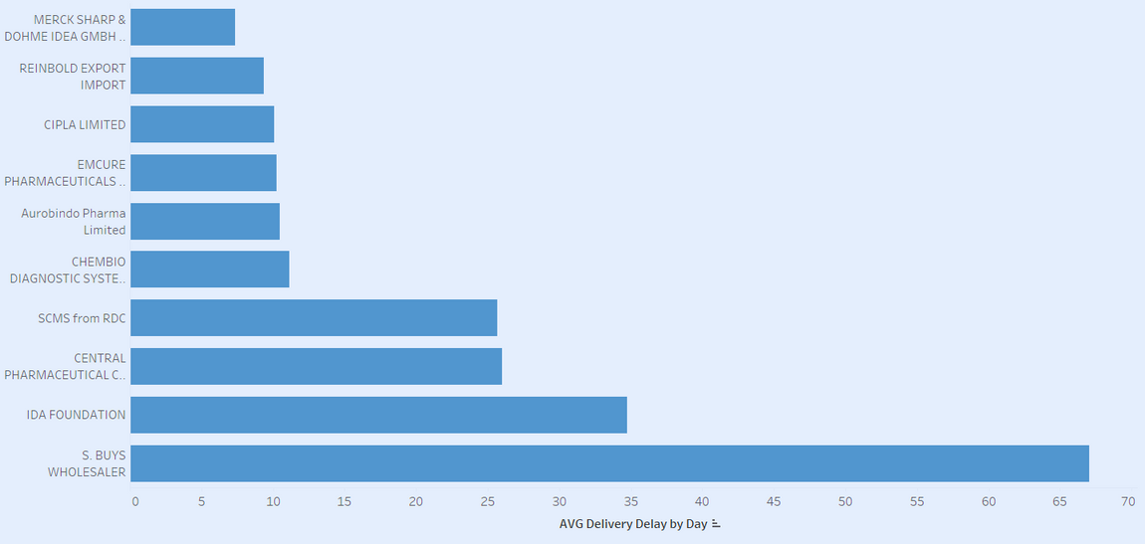
Top 10 Vendors Ranked by Delivery Delay
Description:
A horizontal bar chart ranking the top 10 vendors by their delivery delays, with vendors listed along
•Key Insights:
•Vendor S Buys whole saler has the highest delivery delay, indicating possible inefficiencies in their supply chain or external factors that regularly disrupt their delivery schedules.

Slide 27
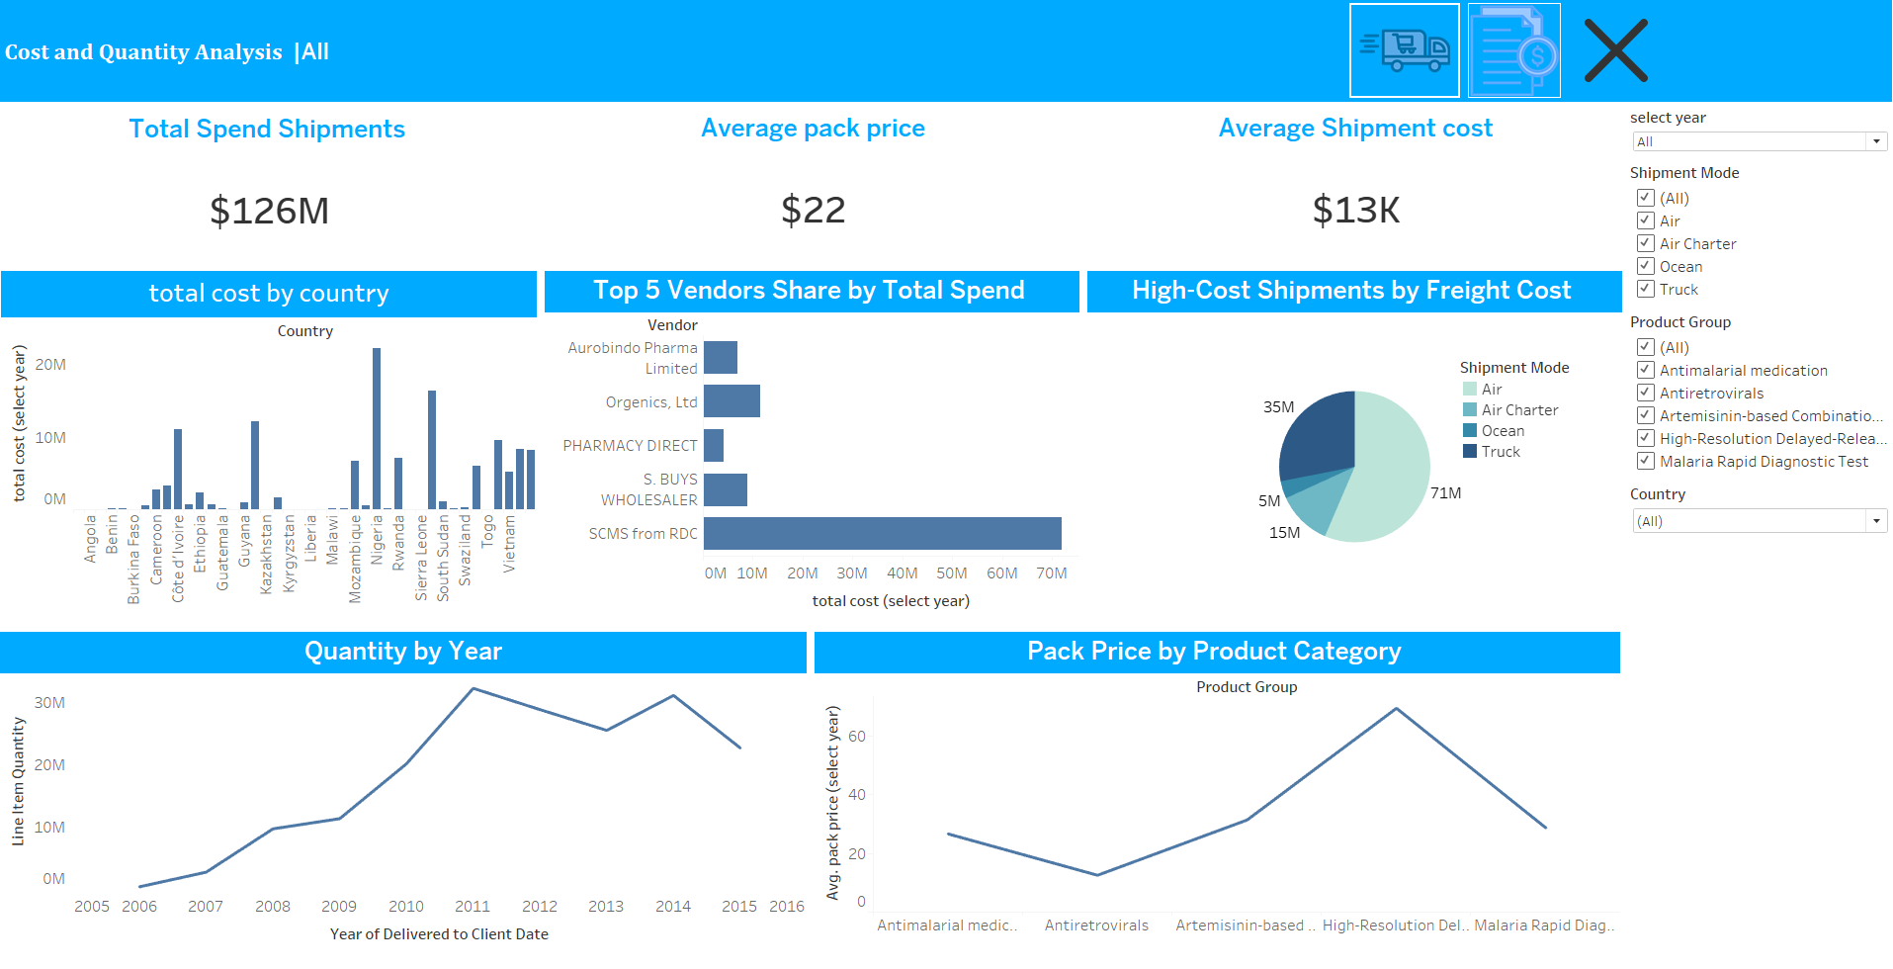
Dashboard 2

Slide 28
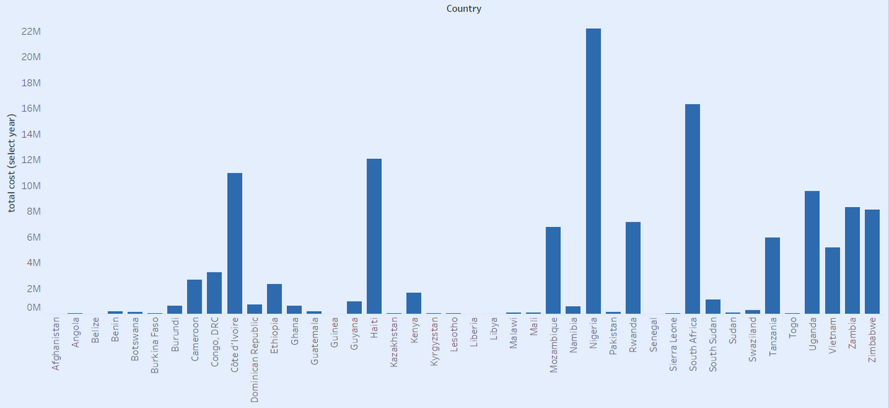
total cost by country
Description:
This bar chart displays the total shipment cost by country
Key Insights:
•Nigeria has the highest total spend on shipments, with $22M spent

Slide 29
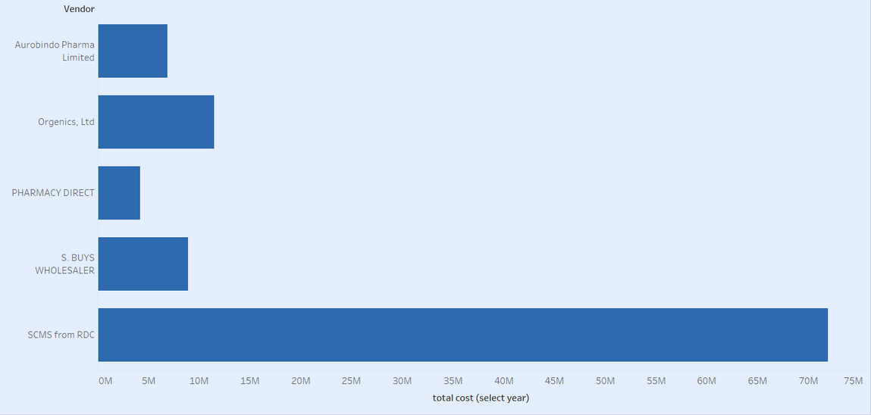
Top 5 Vendors Share by Total Spend
•Description:
A pie chart showing the share of the top 5 vendors by total spend, with each vendor represented as a slice.
•Key Insights:
•Vendor SMCSfrom RDC dominates with $72M of the total spend, likely due to large order volumes or exclusive contracts.

Slide 30
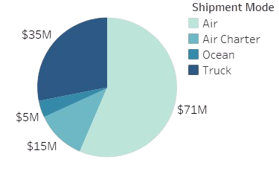
High-Cost Shipments by Freight Cost
Description:
•A pie chart showing the freight spend for each shipment.
Key Insights:
•AIR has the highest freight spend .
•AIR Charter has the lowest freight spend .

Slide 31
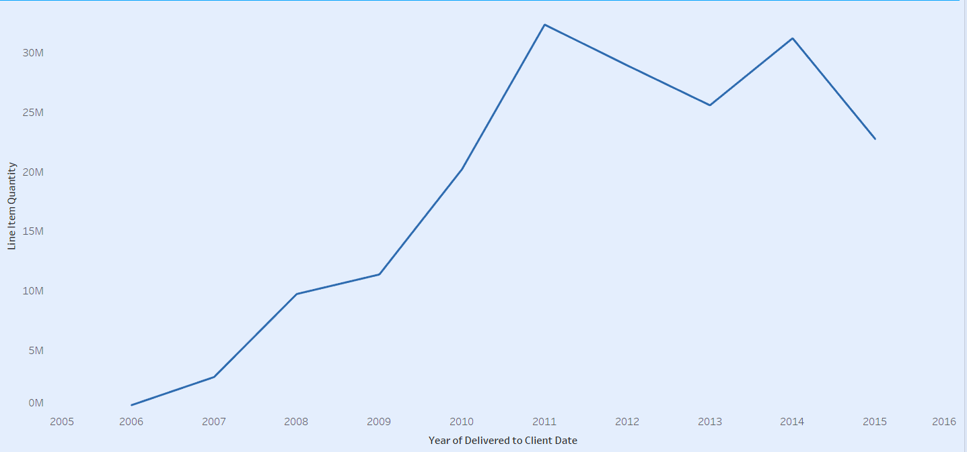
Quantity by Year
Description:
•A line chart that tracks the total quantity of shipments by year.
•Key Insights:
•There is a small drop in production in 2013, 2015, which could be due to slight market fluctuations, temporary supply chain issues, or a dip in demand.

Slide 32
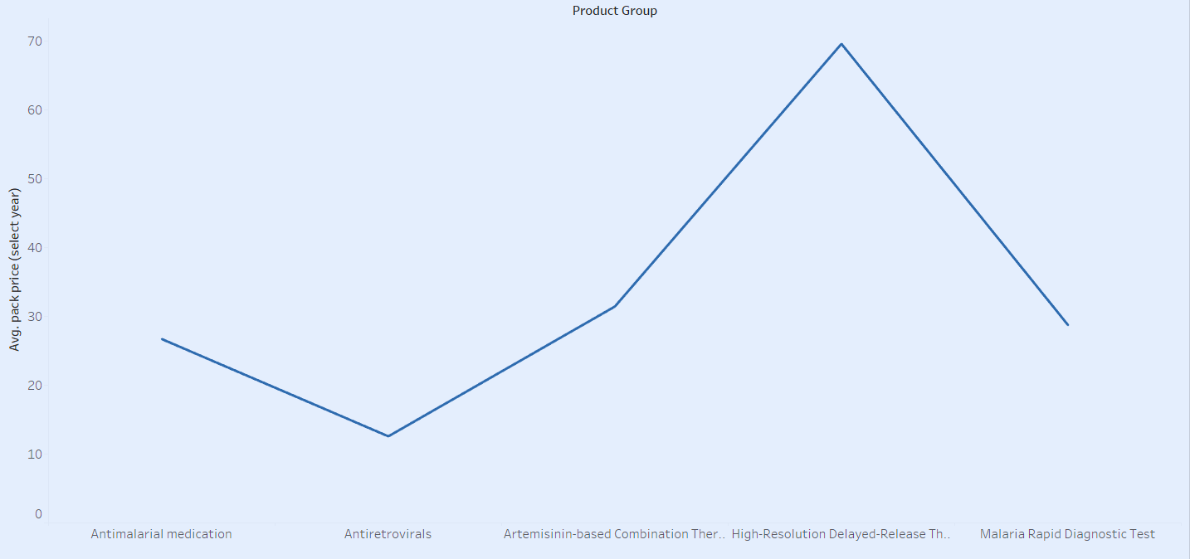
Pack Price by Product Category
Description:
This line chart shows the pack priceacross various product categories.
•Key Insights:
•Category High-Resolution Delayed-Release Therapy,has the highest unit price, likely offering premium products with more expensive materials.
•Category Malaria Rapid Diagnostic Test shows the lowest price, indicating either cost-effective production or increased competition driving prices down

Slide 33
THANK YOU !

